Slide 1


Data Management Layer Design
Chapter 9:
Nhóm 11:
Thành viên :
Tô Mạnh Đức – B18DCCN182
Vũ Danh Hùng – B18DCCN259 Nguyễn Quang Liêm – B18DCCN325
Trần Hùng Minh – B18DCCN413 Vũ Hoàng Long – B18DCCN369

Slide 2

INTRODUCTION
Objectives
Be able to estimate the size of a relational database
Be able to design the data access and manipulation classes
Become familiar with several object-persistence formats
Be able to map problem domain objects to different object-persistence formats.
Be able to apply the steps of normalization to a relational database
Be able to optimize a relational database for object storage and access
Become familiar with indexes for relational databases

Slide 3
INTRODUCTION
The Data Management Layer
Includes both :
- data access and manipulation logic
- the actual design of the storage
Four-step design approach:
1. Selecting the format of the storage
2. Mapping problem-domain objects to object-persistence format
3. optimizing the object-persistence format
4. designing the data access & manipulation classes

Slide 4
II. OBJECT PERSISTENCE FORMATS
Files (Sequential and Random)
Relational databases
Object-relational databases
Object-oriented databases
NoSQL Data Stores

Slide 5

II. OBJECT PERSISTENCE FORMATS
1. Sequential and Random Access Files
Sample File:
Fictitious customer database

Slide 6
II. OBJECT PERSISTENCE FORMATS
1. Sequential and Random Access Files
Sequential access files :
allow sequential operations
Read, write, and search
Efficient for report writing
Searches are not efficient because an average of 50% of records have to be accessed
Two versions :
Ordered
Unordered

Slide 7
II. OBJECT PERSISTENCE FORMATS
1. Sequential and Random Access Files
Random Access Files :
Allow only random or direct file operations
Good for finding and updating a specific object
Inefficient report writing

Slide 8
II. OBJECT PERSISTENCE FORMATS
1. Sequential and Random Access Files
Application File Types :
Master Files
Look-up files
Transaction files
Audit file
History file

Slide 9
II. OBJECT PERSISTENCE FORMATS
2. Relational databases
Collection of tables
Comprised of fields that define entities
Primary key has unique values in each row of a table
Foreign key is primary key of another table
Tables related to each other
Primary key field of a table is a field of another table and called a foreign key
Relationship established by a foreign key of one table connecting to the primary key of another table

Slide 10
II. OBJECT PERSISTENCE FORMATS
2. Relational databases
Database Management System
Software that creates and manipulates a database
RDBMS is a DBMS for a relational database
RDBMS usually support Referential Integrity
the idea of ensuring that values linking the tables together through the primary and foreign keys are valid and correctly synchronized

Slide 11
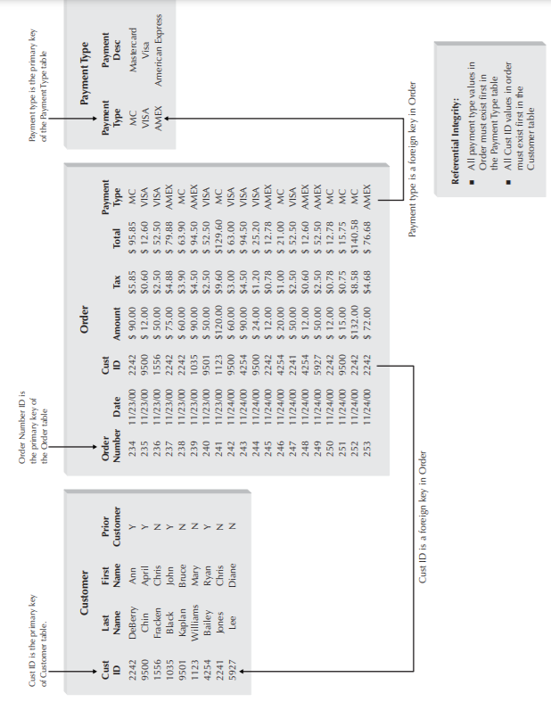
II. OBJECT PERSISTENCE FORMATS
2. Relational databases
Referential Integrity Example
The class Customer has an attribute custID
The class Order has an attribute custID that indicates the customer who placed the order

Slide 12
II. OBJECT PERSISTENCE FORMATS
2. Relational databases
Referential Integrity Example
You should not be able to
create an order for a non-existing customer
delete a customer who has placed orders, unless there is a policy on what to do with those orders
change the custID value of a customer, unless you also change the values of his or her orders

Slide 13
II. OBJECT PERSISTENCE FORMATS
2. Relational databases
The Structured Query Language
Standard language for accessing data in tables
SQL Commands
Create, edit, and delete tables
Add, edit, and delete data
Display data from one or more related tables
Display data computed from data in one or more related tables
SELECT * FROM customers WHERE custID=77

Slide 14
II. OBJECT PERSISTENCE FORMATS
3. Object-relational databases
Object-relational database management systems (ORDBMSs) are relational database management systems with extensions to handle the storage of objects in the relational table structure
ORDBMSs are simply extensions to their RDBMS counterparts

Slide 15
II. OBJECT PERSISTENCE FORMATS
4. Object-Oriented databases
Two primary approaches to supporting object persistence within the OODBMS community:
adding persistence extensions to an object-oriented programming language
creating an entirely separate database management system
With an OODBMS, collections of objects are associated with an extent
OODBMSs provide support for some form of inheritance.
OODBMSs also support the idea of repeating groups (fi elds) or multivalued attributes

Slide 16
II. OBJECT PERSISTENCE FORMATS
5. NoSQL Data Stores
NoSQL data stores are the newest type of object persistence available
There are many different types of NoSQL data stores, including:
key-value stores
document stores
column-oriented stores
object databases

Slide 17
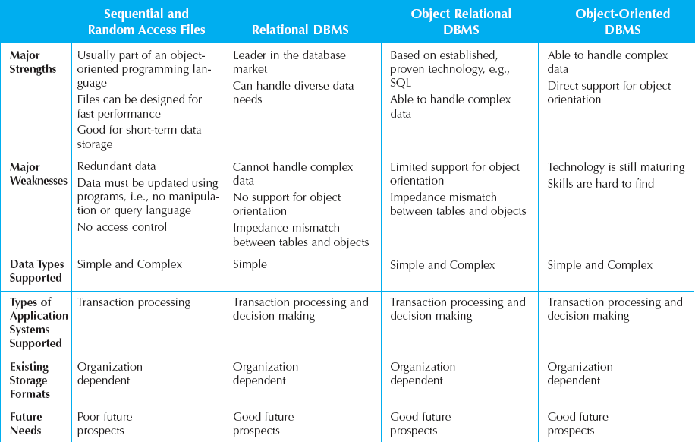
II. OBJECT PERSISTENCE FORMATS
6. Selecting an Object Persistence Format

Slide 18
III. Mapping Problem-Domain Objects to Object-Persistence Formats
1. Mapping PD Objects to an OODBMS Format
Rule 1a: Add a column(s) to the OODBMS class(es) that represents the subclass(es) that will contain an Object ID of the instance stored in the OODBMS class that represents the “additional” superclass(es).
The multiplicity of this new association from the subclass to the “superclass” should be 1..1.
Add a column(s) to the OODBMS class(es) that represents the superclass(es) that will contain an Object ID of the instance stored in the OODBMS class that represents the subclass(es).
An exclusive-or (XOR) constraint must be added between the associations. Do this for each “additional” superclass.
or Rule 1b: Flatten the inheritance hierarchy of the OODBMS classes by copying the attributes and methods of the additional OODBMS superclass(es) down to all of the OODBMS subclasses and remove the additional superclass from the design

Slide 19
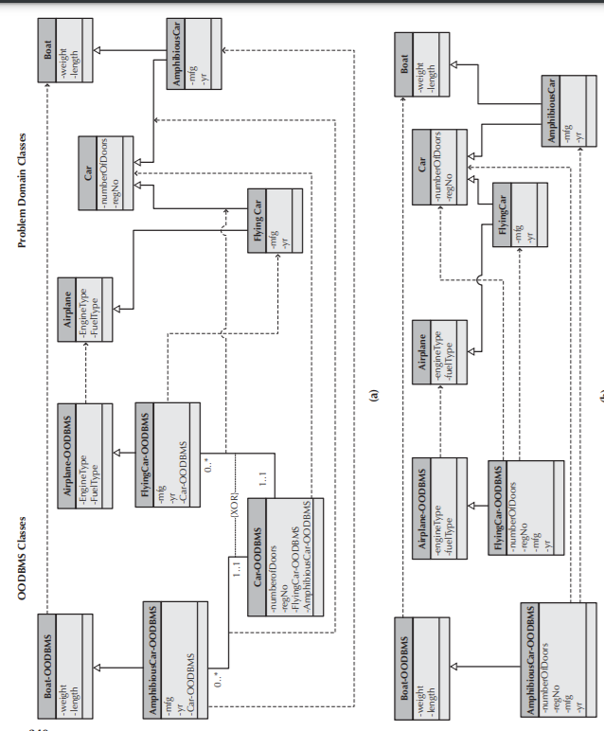
III. Mapping Problem-Domain Objects to Object-Persistence Formats
1. Mapping PD Objects to an OODBMS Format
Mapping Problem Domain Objects to a Single Inheritance-Based OODBMS

Slide 20
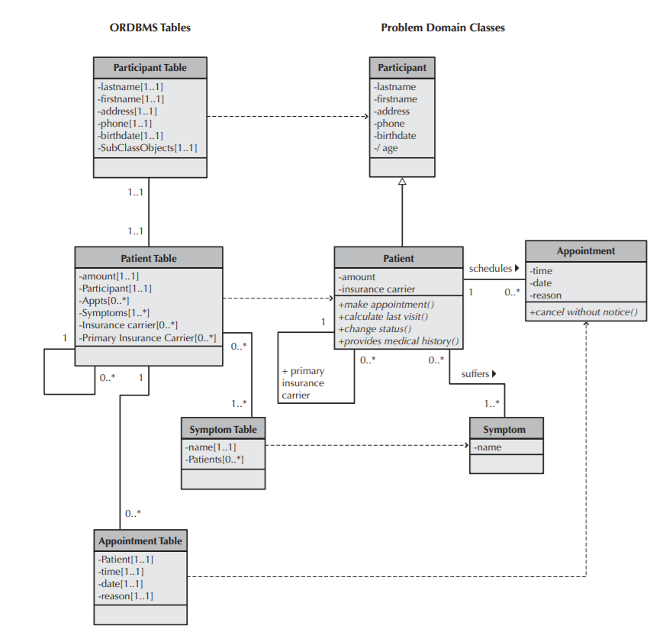
III. Mapping Problem-Domain Objects to Object-Persistence Formats
2. Mapping PD Objects to an ORDBMS Format
Example of Mapping Problem Domain Objects to ORDBMS Schema

Slide 21
III. Mapping Problem-Domain Objects to Object-Persistence Formats
2. Mapping PD Objects to an ORDBMS Format
Rule 1: Map all concrete Problem Domain classes to the ORDBMS tables. Also, if an abstract problem domain class has multiple direct subclasses, map the abstract class to an ORDBMS table.
Rule 2: Map single-valued attributes to columns of the ORDBMS tables.
Rule 3: Map methods and derived attributes to stored procedures or to program modules.
Rule 4: Map single-valued aggregation and association relationships to a column that can store an Object ID. Do this for both sides of the relationship.
Rule 5: Map multivalued attributes to a column that can contain a set of values.
Rule 6: Map repeating groups of attributes to a new table and create a one-to-many association from the original table to the new one.
Rule 7: Map multivalued aggregation and association relationships to a column that can store a set of Object IDs. Do this for both sides of the relationship.

Slide 22
III. Mapping Problem-Domain Objects to Object-Persistence Formats
2. Mapping PD Objects to an ORDBMS Format
Rule 8: For aggregation and association relationships of mixed type (one-to-many or many-to-one), on the single-valued side (1..1 or 0..1) of the relationship, add a column that can store a set of Object IDs. The values contained in this new column will be the Object IDs from the instances of the class on the multivalued side.
Rule 9a: Add a column(s) to the table(s) that represents the subclass(es) that will contain an Object ID of the instance stored in the table that represents the superclass. This is similar in concept to a foreign key in an RDBMS. The multiplicity of this new association from the subclass to the “superclass” should be 1..1. An exclusive-or (XOR) constraint must be added between the associations. Do this for each superclass.
or Rule 9b: Flatten the inheritance hierarchy by copying the superclass attributes down to all of the subclasses and remove the superclass from the design.*.

Slide 23
III. Mapping Problem-Domain Objects to Object-Persistence Formats
3. Mapping PD Objects to a RDBMS Format
Rule 1: Map all concrete-problem domain classes to the RDBMS tables. Also, if an abstract Problem Domain class has multiple direct subclasses, map the abstract class to a RDBMS table.
Rule 2: Map single-valued attributes to columns of the tables.
Rule 3: Map methods to stored procedures or to program modules.
Rule 4: Map single-valued aggregation and association relationships to a column that can store the key of the related table, i.e., add a foreign key to the table. Do this for both sides of the relationship.
Rule 5: Map multivalued attributes and repeating groups to new tables and create a one-to-many association from the original table to the new ones.
Rule 6: Map multivalued aggregation and association relationships to a new associative table that relates the two original tables together….

Slide 24
III. Mapping Problem-Domain Objects to Object-Persistence Formats
3. Mapping PD Objects to a RDBMS Format
Rule 7: For aggregation and association relationships of mixed type, copy the primary key from the single-valued side (1..1 or 0..1) of the relationship to a new column in the table on the multivalued side (1..* or 0..*) of the relationship that can store the key of the related table, i.e., add a foreign key to the table on the multivalued side of the relationship.
Rule 8a: Ensure that the primary key of the subclass instance is the same as the primary key of the superclass. Furthermore, an exclusive-or (XOR) constraint must be added between the associations….
or Rule 8b: Flatten the inheritance hierarchy by copying the superclass attributes down to all of the subclasses and remove the superclass from the design

Slide 25
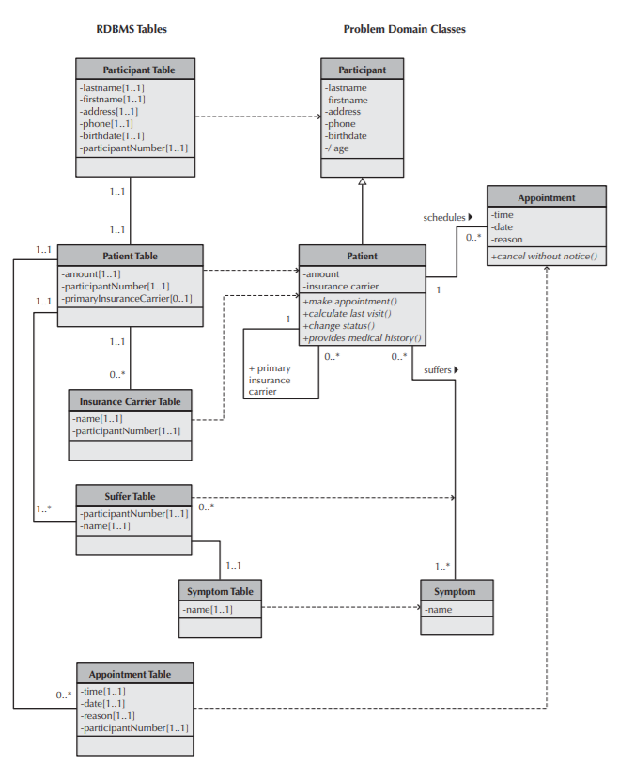
III. Mapping Problem-Domain Objects to Object-Persistence Formats
3. Mapping PD Objects to a RDBMS Format
Example of Mapping Problem Domain Objects to RDBMS Schema

Slide 26
IV. OPTIMIZING RDBMS-BASED OBJECT STORAGE
1. Optimizing Storage Efficiency
No redundant data
Wastes space
Allows more room for error
Few null values in tables
Difficult to interpret

Slide 27
IV. OPTIMIZING RDBMS-BASED OBJECT STORAGE
1. Optimizing Storage Efficiency
Normalization
Tells us how well-formed data is in an RDBMS
Reduces data redundancies
First four levels of normalization are
0 Normal Form: normalization rules not applied
1 Normal Form: no multi-valued fields
2 Normal Form: depend on a whole primary keys
3 Normal Form: no fields depend on non-primary key fields

Slide 28
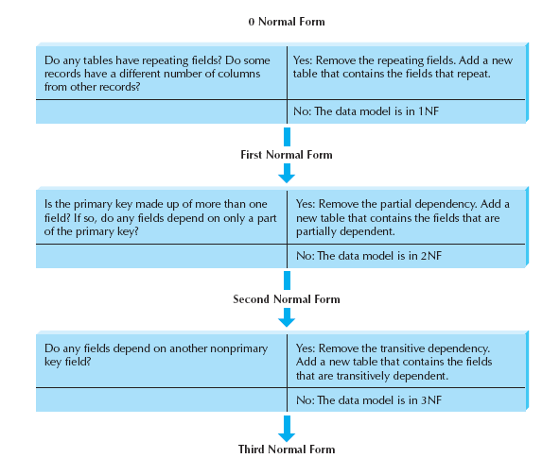
IV. OPTIMIZING RDBMS-BASED OBJECT STORAGE
1. Optimizing Storage Efficiency
Steps of Normalization

Slide 29
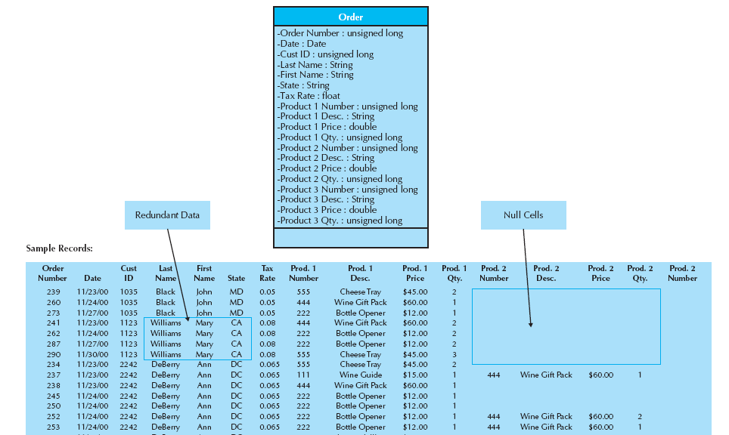
IV. OPTIMIZING RDBMS-BASED OBJECT STORAGE
1. Optimizing Storage Efficiency
Optimizing Storage Example – 0NF

Slide 30
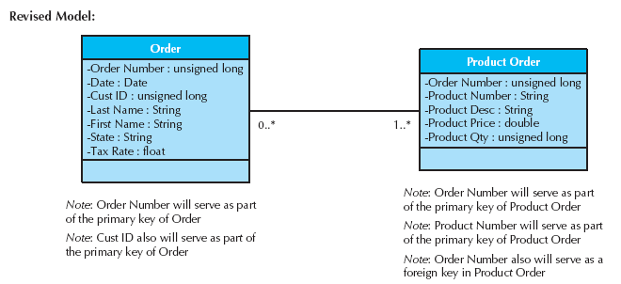
IV. OPTIMIZING RDBMS-BASED OBJECT STORAGE
1. Optimizing Storage Efficiency
Remove Repeating Fields– 1NF

Slide 31
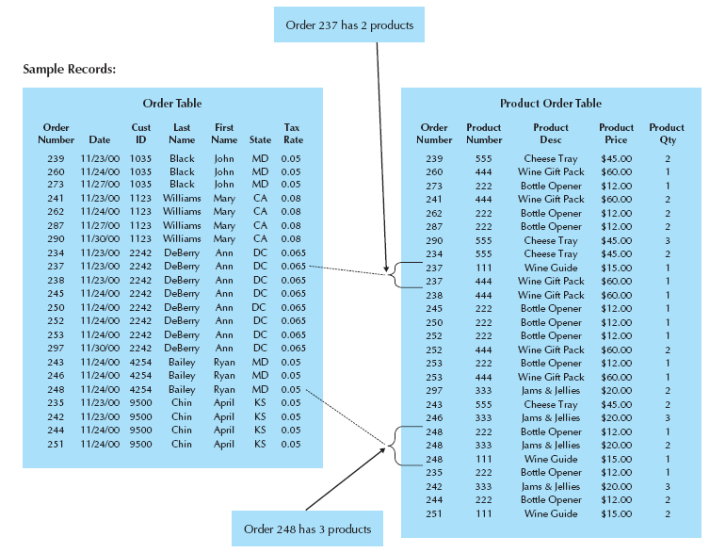
IV. OPTIMIZING RDBMS-BASED OBJECT STORAGE
1. Optimizing Storage Efficiency
1NF Sample Records

Slide 32
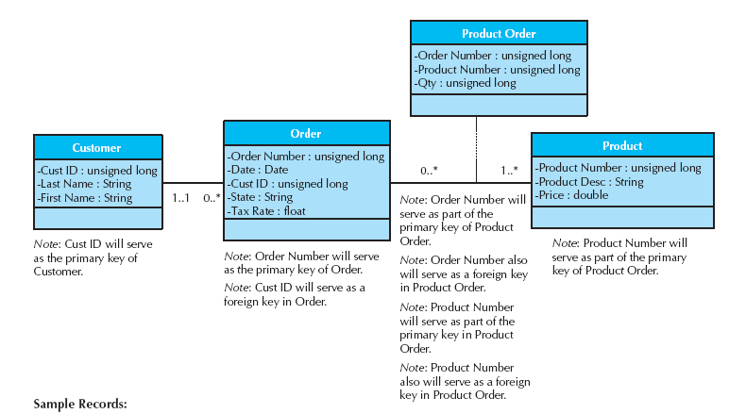
IV. OPTIMIZING RDBMS-BASED OBJECT STORAGE
2. Optimizing Data Access Speed
Partial Dependencies Removed – 2NF
Denormalization

Slide 33
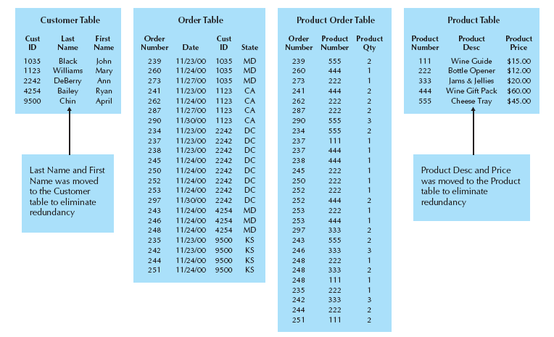
IV. OPTIMIZING RDBMS-BASED OBJECT STORAGE
2. Optimizing Data Access Speed
2NF Sample Records

Slide 34
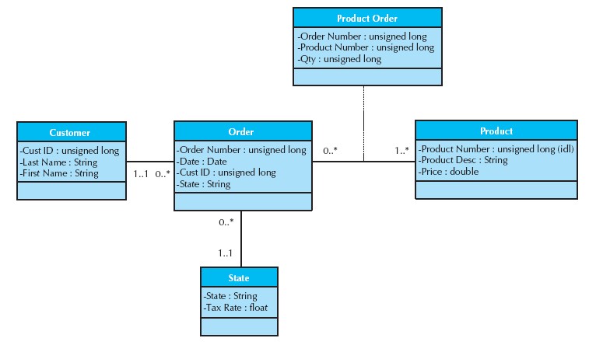
IV. OPTIMIZING RDBMS-BASED OBJECT STORAGE
2. Optimizing Data Access Speed
Normalized Field– 3NF

Slide 35
IV. OPTIMIZING RDBMS-BASED OBJECT STORAGE
2. Optimizing Data Access Speed
Join table can take a lot of time, especially if the tables are large or if many tables are involved
The project team can use several techniques to try to speed up access to the data, including denormalization, clustering, and indexing
Denormalization
Clustering
Indexing

Slide 36
IV. OPTIMIZING RDBMS-BASED OBJECT STORAGE
2. Optimizing Data Access Speed
Denormalization
Denormalization reduces the number of joins that need to be performed in a query, thus speeding up access
Denormalization is ideal in situations in which information is queried frequently but updated rarely
There are three cases in which you may rely upon denormalization to reduce joins and improve performance
First, denormalization can be applied in the case of look-up tables, which are tables that contain descriptions of values
Second, one-to-one relationships are good candidates for denormalization
Third, at times it is more efficient to include a parent entity’s attributes in its child entity on the physical data model

Slide 37
IV. OPTIMIZING RDBMS-BASED OBJECT STORAGE
2. Optimizing Data Access Speed
Clustering
Speed of access also is influenced by the way that the data are retrieved
Method is to cluster records together physically so that similar records are stored close together
=> Whenever a query looks for records, it can go directly to the right spot on the disk because it knows in what order the records are stored

Slide 38
IV. OPTIMIZING RDBMS-BASED OBJECT STORAGE
2. Optimizing Data Access Speed
Indexing
An index in data storage is a minitable that contains values from one or more columns in a table and the location of the values within the table
A query can use an index to find the locations of only those records that are included in the query answer
A table can have an unlimited number of indexes
Make indexes perform even faster by placing them into the main memory of the data storage hardware

Slide 39
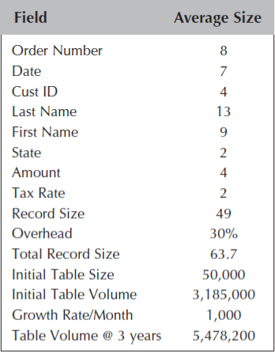
IV. OPTIMIZING RDBMS-BASED OBJECT STORAGE
3. Estimating Data Storage Size
Even if we have denormalized our physical data model, clustered records, and created indexes appropriately, the system will perform poorly if the database server cannot handle its volume of data
The size of the database is based on the amount of raw data in the tables and the overhead requirements of the DBMS.
Raw data refers to all the data that are stored within the tables of the database

Slide 40
V. DESIGNING DATA ACCESS & MANIPULATION CLASSES
Data Access & Manipulation
The final step in developing the data management layer is to design
Data access & manipulation (DAM) classes act as a translator between the object-persistence and the problem domain objects
There should be one DAM class for each concrete problem domain class

Slide 41
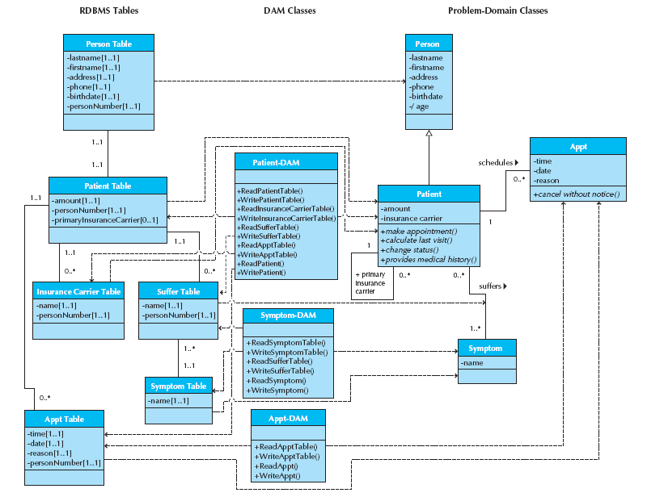
V. DESIGNING DATA ACCESS & MANIPULATION CLASSES
Example DAM Classes

Slide 42
VI. NONFUNCTIONAL REQUIREMENTS AND DATA MANAGEMENT LAYER DESIGN
Nonfunctional requirements refer to behavioral properties that the system must have
we have grouped nonfunctional requirements into four categories:
Operational
Performance
Security
Cultural and political requirements

Slide 43
VI. NONFUNCTIONAL REQUIREMENTS AND DATA MANAGEMENT LAYER DESIGN
operational requirements
For the data management layer include issues that deal with the technology being used to support object persistence
The choice of the hardware and operating system limits the choice of the technology and format of the object persistence available
One possible choice to support object persistence that works both on Google’s Android and Apple’s iOS-based platforms is SQLite. SQLite is a lightweight version of SQL that supports RDBMS.

Slide 44
VI. NONFUNCTIONAL REQUIREMENTS AND DATA MANAGEMENT LAYER DESIGN
performance requirements
Affect the data management layer are speed and capacity
An additional requirement that can affect the design of the data management layer deals with the availability of the objects being stored.

Slide 45
VI. NONFUNCTIONAL REQUIREMENTS AND DATA MANAGEMENT LAYER DESIGN
security requirements
Deal primarily with access controls, encryption, and backup:
Access control can be set to guarantee that only users with “administrator” privileges are allowed to modify the object storage schema or access controls
Encryption requirements on this layer deal with whether the object should be stored in an encrypted format or not
Backup requirements deal with ensuring that the objects are routinely copied and stored in case the object store becomes corrupted or unusable

Slide 46
VI. NONFUNCTIONAL REQUIREMENTS AND DATA MANAGEMENT LAYER DESIGN
political and cultural requirements
Can affect the data management layer.
Include issues related to the expected number of characters that should be allocated for a data field, the format of a data field, and the issues related to security

Slide 47
VII. VERIFYING AND VALIDATING THE DATA MANAGEMENT LAYER
Verifying and validating the design of the data management layer fall into three basic groups:
First:
we recommend verifying and validating any changes made to the problem domain by performing walkthroughs of the modified functional models, structural models, and behavioral models. Furthermore, all of the models must be consistent and balanced .
if any problem domain class was modified that was associated with a use-case scenario, that scenario should be tested again through role-playing.

Slide 48
VII. VERIFYING AND VALIDATING THE DATA MANAGEMENT LAYER
Second:
The dependency of the object persistence instances on the problem domain must be enforced.
Third :
The design of the data access and manipulation classes need to be tested to ensure that they are dependent on the problem domain classes and the object persistence format, not the other way around

Slide 49

Thank You!
someone@Example.com

